Slide 1

EAT FRESH (ONLINE GROCERY SHOPPING) Individual Project Java Full Stack Developer By K . Priyanka (EBEONO62139204) Under the guidance of Shalini Kumari (Technical Trainer)
Edu Bridge Learning

Slide 2
CONTENTS
Introduction
Software & Hardware details
View of Web Page
Advantages
Disadvantages
Future Scope
Conclusion

Slide 3
Introduction
The Internet provides consumers with a new medium of obtaining useful information and for purchasing goods, information and services.
The main purpose of online grocery is to create and develop new models, and to optimize the relationships between a grocery company and its customers.
Changing from shopping at the supermarket to online grocery shopping can improve an online grocery retailer’s productivity by shortening supply chains, reducing overhead costs, and enabling “just in time” service. Most grocery store chains offer online shopping options with free in-store pickup; a few even offer home delivery for a small fee.

Slide 4
Software & Hardware details
Software Requirements
Platform : HTML & CSS
IDE : VS Code
Editor : Windows 10
Hardware Requirements
Intel Core
8 GB Ram
Minimum Requirements
Intel Core/AMD
256MB RAM

Slide 5
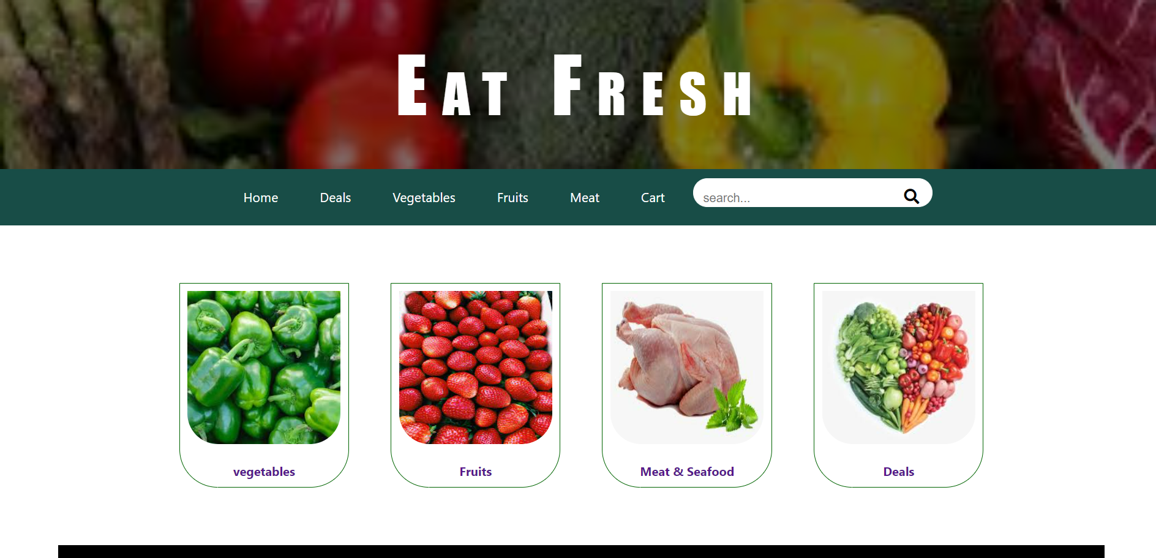
Main Page

Slide 6
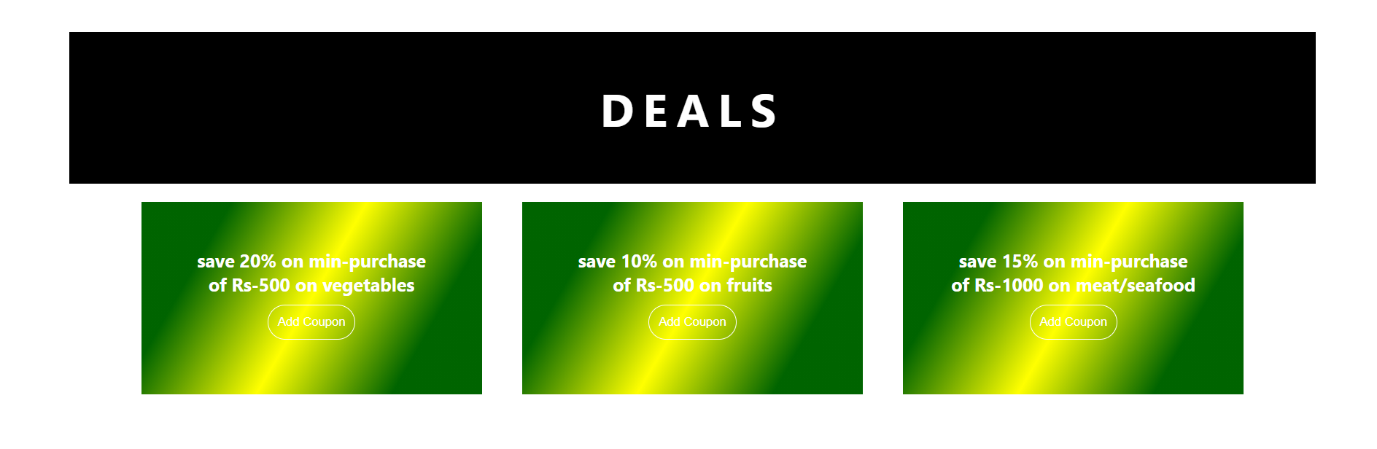
Deals Session

Slide 7
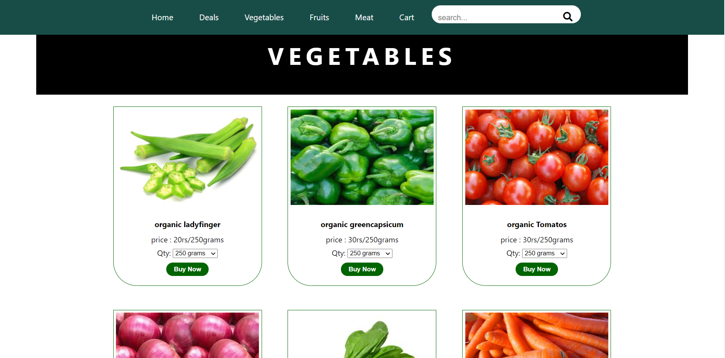
Vegetables Session

Slide 8
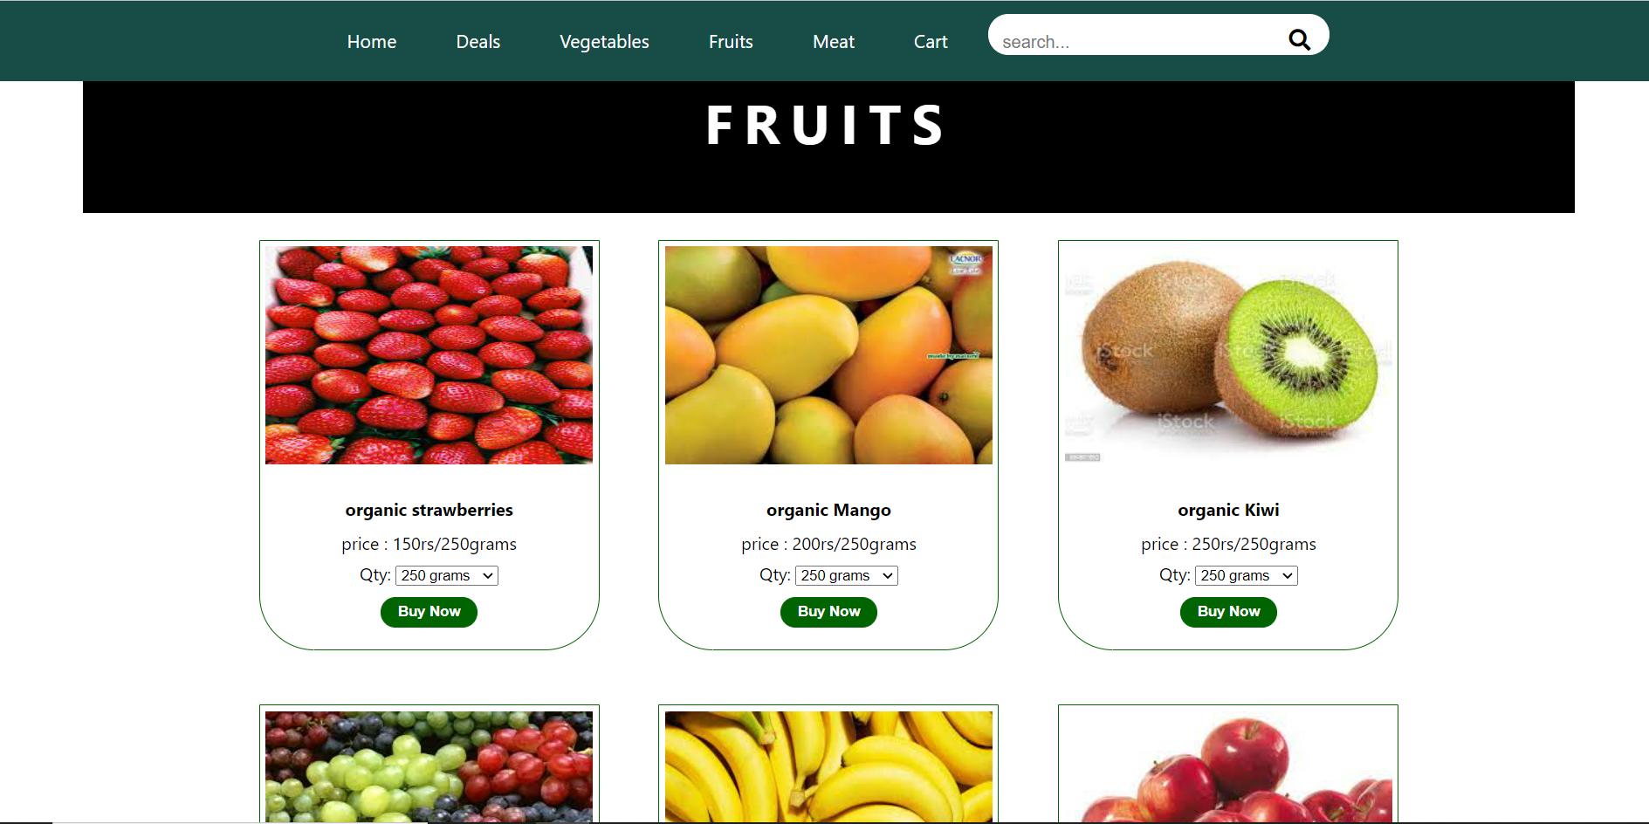
Fruits Session

Slide 9
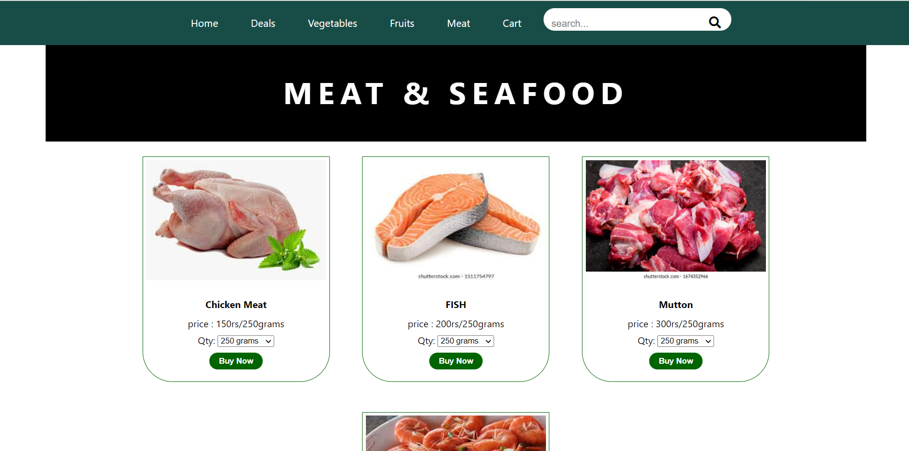
Meat Session

Slide 10
Advantages
You are far less likely to overspend. When shopping online, most people usually have a list of items that are needed and it’s easy stick to it.
It saves time. You can shop online, choose a pick up time and on your way home have your groceries loaded in your car or have them delivered to your home. All of this is done without stepping foot in a grocery store, leaving more time for work, family or leisure activities.
It is far less stressful than dealing with busy grocery stores at peak hours when everyone else is there.
Most grocery sites store your last shopping list. This makes it easier to reorder items and make adjustments.

Slide 11
Disadvantages
1. Not able to touch or try.
2. Shipping and handling cost is more.
3. Credit/Debit card insecurity.
4. Take much time if connection is slow.
5. Returning goods is difficult.
6. Actual product may differ.
7. Availability of internet is a must.

Slide 12
Future Scope
I would like to add Login Page for User , to provide more security for user.
Add some more sessions related to grocery items like pulses, Spices etc.
By adding more features like providing best deals according seasons.

Slide 13
Conclusion
It is an user friendly application and promotes user to purchase and shop faster.
With new technology comes better way of doing things.
Being able to buy anytime anywhere.
Allows to place order before purchasing.
Home delivery you don’t have to travel to shop.

Slide 14


